Slide 1


Dynamic Spatio-Temporal Specialization Learning for Fine-Grained Action Recognition
Tianjiao Li¹*, Lin Geng Foo¹*, Qiuhong Ke², Hossein Rahmani³, Anran Wang⁴, Jinghua Wang⁵, and Jun Liu¹
¹ ISTD Pillar, Singapore University of Technology and Design
² Department of Data Science & AI, Monash University
³ School of Computing and Communications, Lancaster University
⁴ ByteDance
³ School of Computer Science and Technology, Harbin Institute of Technology
^{* Equal Contribution}
Notes:
Hello everyone, I am Lin Geng from Singapore University of Technology and Design, and today I will be presenting about our paper titled Dynamic Spatio-Temporal Specialization Learning for Fine-Grained Action Recognition

Slide 2
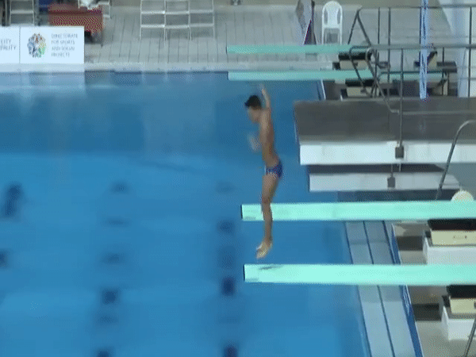
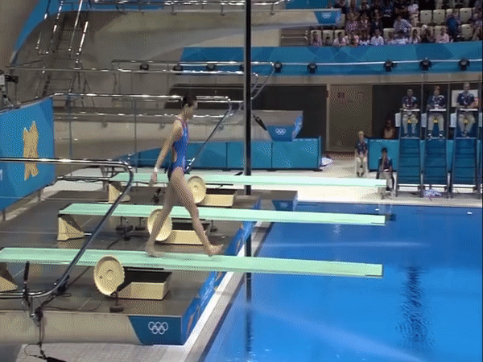
Fine-Grained Action Recognition
['Forward', '15som', 'NoTwis', 'PIKE']
['Reverse', '15som', '25Twis', 'FREE']
GIFs from Diving48 Dataset
Image from Li et al. RESOUND: Towards Action Recognition without Representation Bias. ECCV 2018.
Notes:
Fine-grained action recognition involves distinguishing between similar actions with only subtle differences.
For example, we might need to distinguish between the number of somersaults or twists that a diver performs, or other characteristics of the dive.
This high inter-class similarity in the fine-grained setting makes it a challenging task, that coarse-grained backbones often struggle to overcome.

Slide 3
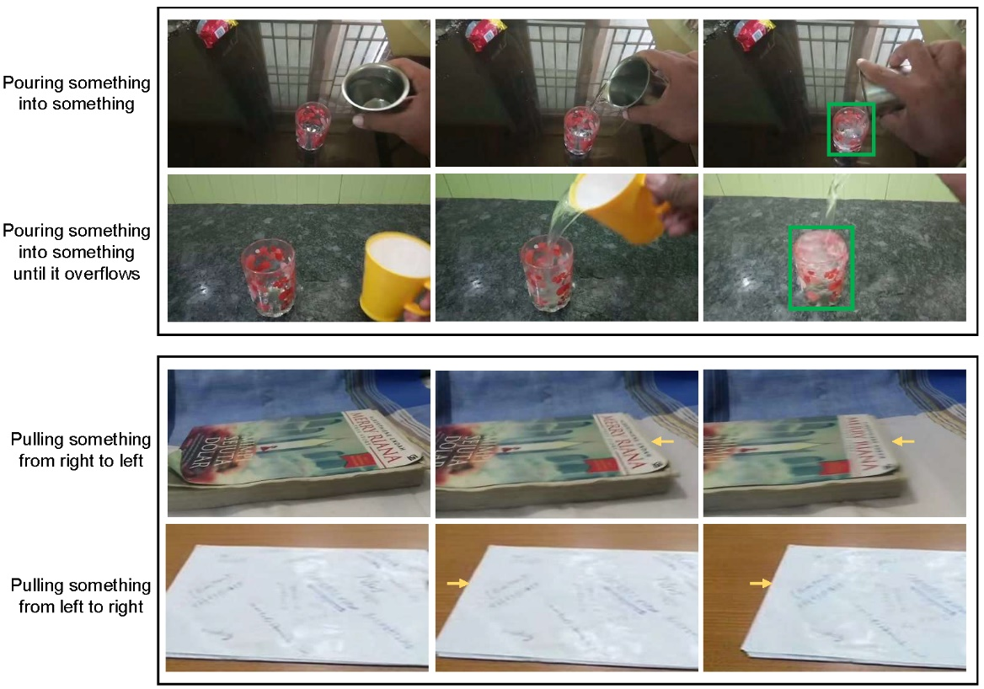
Spatial vs Temporal Fine-grained Differences
Fine-grained differences can exist in spatial or temporal aspects. A greater emphasis on the important aspect w.r.t the input video can improve performance
Notes:
Furthermore, fine-grained differences can exist in spatial or temporal aspects.
For example, some fine-grained differences lie mainly in the spatial aspects of two actions, e.g., “Pouring something into something” and “Pouring something into something and it overflows”.
In contrast, some fine-grained differences lie more in the temporal aspects of two actions, e.g., “Pulling something from right to left” and “Pulling something from left to right”.
In each case, placing a greater emphasis on the important aspect of each video will lead to better recognition performance, which motivates us to explore spatio-temporal specialization.
Therefore, spatial and temporal specialization will allow us to place a greater emphasis on the important aspect w.r.t the input video and improve performance
Therefore, spatial and temporal specialization has clear benefits for fine-grained action recognition.
In this case, a greater emphasis on the spatial dimension of each video will lead to better recognition performance.

Slide 4
Dynamic Spatio-Temporal Specialization
Overview: We design a DSTS module to handle fine-grained differences.
There are L layers within the DSTS module, each comprising N specialized neurons.
In the forward pass, specialized neurons are dynamically activated based on the input.
Notes:
Thus, we design a Dynamic Spatio Temporal Specialization (DSTS) module to handle fine-grained action recognition.
There are L layers within the DSTS module, each comprising N specialized neurons.
In the forward pass, specialized neurons are dynamically activated based on the input.
We design a novel Dynamic Spatio-Temporal Specialization (DSTS) module, which consists of specialized neurons that are only activated for a subset of samples that are highly similar.
During training, the training loss forces the specialized neurons to learn discriminative fine-grained differences to distinguish between these similar samples, improving finegrained recognition.
The DSTS module consists of specialized neurons that are only activated for a subset of samples that are highly similar.
In particular, a synapse mechanism dynamically activates each specialized neuron only on a subset of samples
that are highly similar, such that only fine-grained differences exist between them. During training, in order to distinguish
among that particular subset of similar samples, the loss will push the specialized neurons to focus on
exploiting the fine-grained differences between them.
There are L layers within
the DSTS module, each comprising N specialized
neurons (grey rectangles). When a
feature map X is fed into the j-th DSTS
layer, impulse values vij from each specialized
neuron nij are first calculated, and
the specialized neuron with the highest impulse
value in that layer is activated (indicated
with red arrows) using the Gumbel-
Softmax technique (indicated with G○). A
skip connection adds general features from
the backbone to the output of the DSTS
module (indicated with
L
), before being
fed into the classifier.

Slide 5
Dynamic Spatio-Temporal Specialization
A Synapse Mechanism dynamically activates each specialized neuron only on a subset of samples that are highly similar, such that only fine-grained differences exist between them.
During training, in order to distinguish
among that subset of similar samples, the loss will push the specialized neurons to focus on
exploiting the fine-grained differences between them.
Notes:
Specifically, we design a Synapse Mechanism that dynamically activates each specialized neuron only on a subset of samples that are highly similar, such that only fine-grained differences exist between them.
Thus, during training, in order to distinguish among that subset of similar samples, the loss will push the specialized neurons to focus on exploiting the fine-grained differences between them.
We design a novel Dynamic Spatio-Temporal Specialization (DSTS) module, which consists of specialized neurons that are only activated for a subset of samples that are highly similar.
During training, the training loss forces the specialized neurons to learn discriminative fine-grained differences to distinguish between these similar samples, improving finegrained recognition.
When a feature map X is fed into the j-th DSTS layer, impulse values v_{ij} from each specialized neuron n_{ij} are first calculated, and the specialized neuron with the highest impulse value in that layer is activated (indicated with red arrows) using the Gumbel-Softmax technique
In particular, a synapse mechanism dynamically activates each specialized neuron only on a subset of samples
that are highly similar, such that only fine-grained differences exist between them. During training, in order to distinguish
among that particular subset of similar samples, the loss will push the specialized neurons to focus on
exploiting the fine-grained differences between them.
There are L layers within
the DSTS module, each comprising N specialized
neurons (grey rectangles). When a
feature map X is fed into the j-th DSTS
layer, impulse values vij from each specialized
neuron nij are first calculated, and
the specialized neuron with the highest impulse
value in that layer is activated (indicated
with red arrows) using the Gumbel-
Softmax technique (indicated with G○). A
skip connection adds general features from
the backbone to the output of the DSTS
module (indicated with
L
), before being
fed into the classifier.

Slide 6
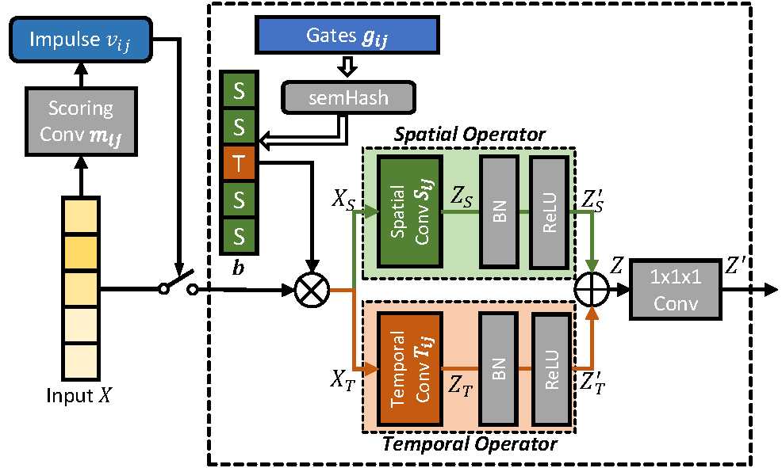
Dynamic Spatio-Temporal Specialization
We also design a Spatio-Temporal Specialization method that additionally provides specialized neurons with spatial or temporal specializations, allowing them to have to higher sensitivity towards the fine-grained differences in those aspects.
Specialized neuron with Spatio-Temporal Specialization
Notes:
(Read directly)
To allow our module to efficiently and effectively handle fine-grained differences over a large range of spatio-temporal variations, we design a \textit{spatio-temporal specialization} method that additionally provides specialized neurons with spatial or temporal specializations.
To achieve such specialization, we explicitly design the specialized neurons to focus only on one single aspect (spatial or temporal) for each channel of the input feature map at a time, forcing the neurons to exploit fine-grained differences between similar samples in that specific aspect, leading to higher sensitivity towards these fine-grained differences.
This allows our module to efficiently and effectively handle fine-grained differences over a large range of spatio-temporal variations.

Slide 7
Dynamic Spatio-Temporal Specialization
Highlights of the Design
Each specialized neuron is designed with a Spatial Operator and a Temporal Operator in each channel
Gate parameters in each channel control the choice of operator, and are optimized during training, adapting the architecture of the specialized neuron
The set of neurons will have diversified architectures, which collectively are capable of handling a large variety of spatial and temporal fine-grained differences
Specialized neuron with Spatio-Temporal Specialization
Notes:
Specifically, ….
(Read directly)
Specifically, this is implemented using \textit{gates} that determine whether a \textit{spatial operator} or a \textit{temporal operator}is used to process each input channel. By adjusting their gate parameters, specialized neurons that benefit from discerning spatial or temporal patterns adapt their architectures to use the corresponding operator across more channels.Eventually, the set of specialized neurons will have diversified architectures and specializations focusing on different spatial and temporal aspects, which collectively are capable of handling a large variety of spatial and temporal fine-grained differences.

Slide 8
Upstream-Downstream Learning
Motivations of UDL
Our Upstream-Downstream Learning (UDL) algorithm better optimizes the model parameters involved in making dynamic decisions.
This is because upstream parameters that make dynamic decisions and downstream parameters that process input, are jointly trained during our end-to-end training, which can be challenging as upstream parameters themselves also affect the training of downstream parameters.
Notes:
Next, to further improve the performance of our DSTS module, we design an Upstream-Downstream Learning (UDL) algorithm that better optimizes the model parameters involved in making dynamic decisions.
This is because upstream parameters that make dynamic decisions and downstream parameters that process input, are jointly trained during our end-to-end training, which can be challenging as upstream parameters themselves also affect the training of downstream parameters.
Essentially, Our Upstream-Downstream Learning algorithm leverages on meta-learning to optimize the upstream parameters while taking their downstream effects into account.
I refer the audience to the paper for a more in-depth discussion.

Slide 9
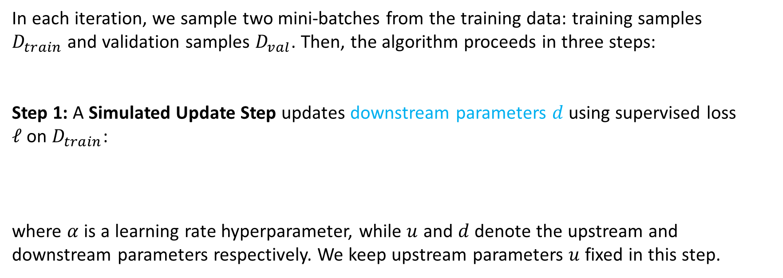
Upstream-Downstream Learning
In each iteration, we sample two mini-batches from the training data: training samples $D_{train}$and validation samples $D_{val}$. Then, the algorithm proceeds in three steps:
Step 1: A Simulated Update Step updates downstream parameters $d$ using supervised loss $ℓ$on $D_{train}$:
where $α$is a learning rate hyperparameter, while $u$ and $d$ denote the upstream and downstream parameters respectively. We keep upstream parameters $u$ fixed in this step.
$\hat{d}= d − α∇_{d}ℓ(u,d;D_{train})$
Notes:
This simulates the training process of the downstream parameters when the current set of upstream parameters are used to make dynamic decisions.

Slide 10
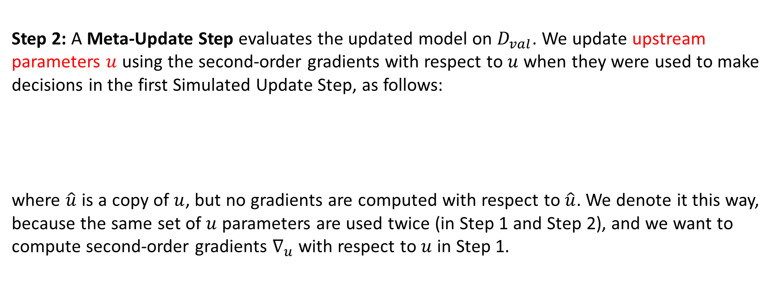
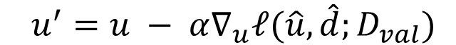
Upstream-Downstream Learning
Step 2: A Meta-Update Step evaluates the updated model on $D_{val}$. We update upstream parameters $u$ using the second-order gradients with respect to $u$when they were used to make decisions in the first Simulated Update Step, as follows:
where $\hat{u}$is a copy of $u$, but no gradients are computed with respect to $\hat{u}$. We denote it this way, because the same set of $u$ parameters are used twice (in Step 1 and Step 2), and we want to compute second-order gradients $∇_{u}$with respect to $u$in Step 1.
$u^{′}=u − α∇_{u}ℓ(\hat{u},\hat{d};D_{val})$
Notes:
In the crucial second step, we evaluate the model's performance on held-out samples in a validation set, which estimates model performance on unseen samples.
The second-order gradients (with respect to upstream parameters) from this evaluation provide feedback on how upstream parameters can be updated such that their \textit{dynamic decisions during training can improve the learning process of downstream parameters}, leading to better performance on unseen samples.
These second-order gradients $∇_{u}$provide feedback on how to adjust $u$such that their dynamic decisions lead to better training of the downstream parameters (as simulated in the Simulated Update Step), resulting in improved performance on unseen samples.

Slide 11
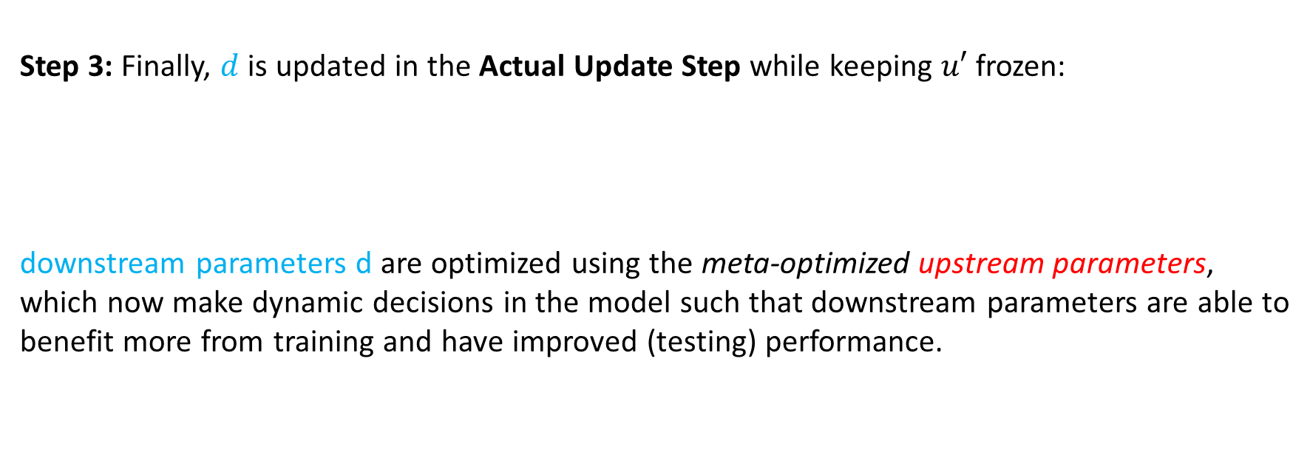
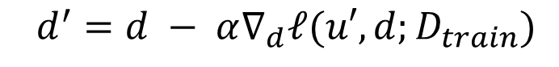
Upstream-Downstream Learning
Step 3: Finally, $d$is updated in the Actual Update Step while keeping $u′$ frozen:
downstream parameters d are optimized using the meta-optimized upstream parameters, which now make dynamic decisions in the model such that downstream parameters are able to benefit more from training and have improved (testing) performance.
$d^{′}=d − α∇_{d}ℓ(u′,d;D_{train})$
Notes:
In the final step, downstream parameters are optimized using the \textit{meta-optimized upstream parameters}, which now make dynamic decisions in the model such that downstream parameters are able to benefit more from training and have improved (testing) performance.
One iteration of this algorithm concludes here, and we obtain updated parameters $u′$ and $d′$.

Slide 12
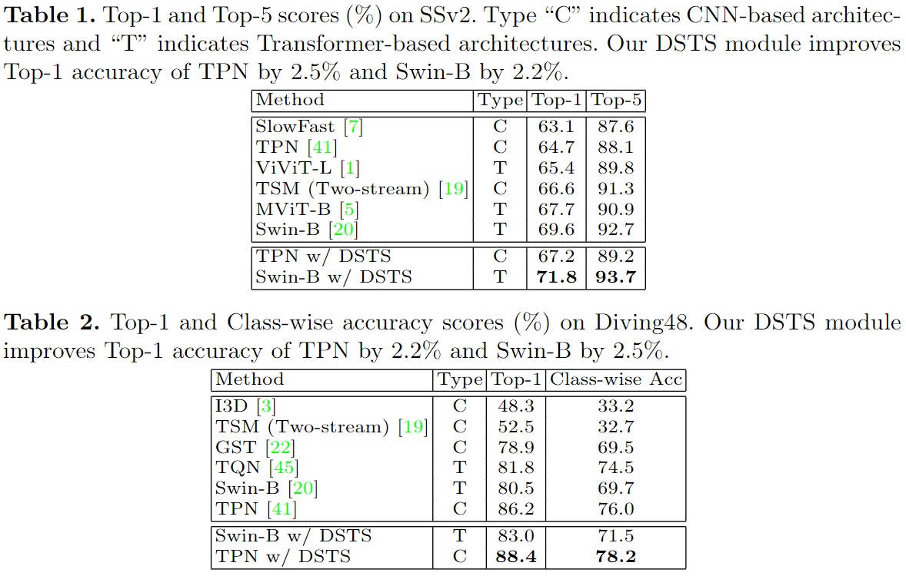
Experiments
Results on SSv2
Results on Diving48
Notes:
We conduct experiments on two popular datasets, the Something Something v2 dataset, and the Diving48 dataset.
Our method achieves state-of-the-art performance on both of them.

Slide 13
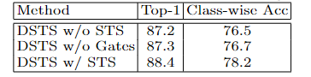
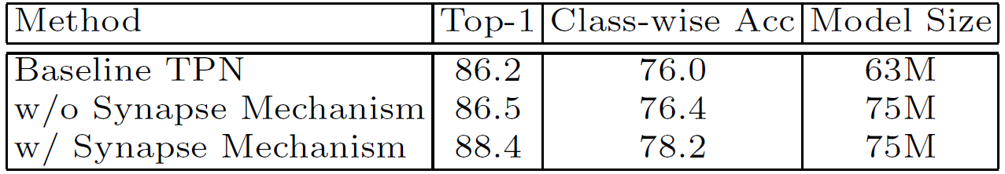
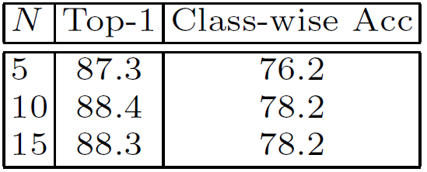
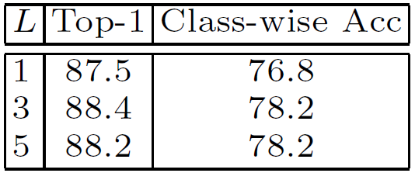
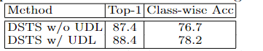
Ablations on Diving48
Spatio-Temporal Specialization
Synapse Mechanism
Impact of N and L
Upstream-Downstream Learning
Notes:
We also conduct some ablation studies on some aspects of our design.
Briefly, this shows that our gates can learn channel-wise architectures that are more specialized and effective for fine-grained recognition compared to other handcrafted alternatives..
This shows that our dynamic Synapse Mechanism design performs better than alternative designs with the same number of parameters.
Here, our Upstream-Downstream Learning algorithm is also shown to be effective.
We also found that increasing our N and L hyperparameters further did not lead to further improvement.

Slide 14
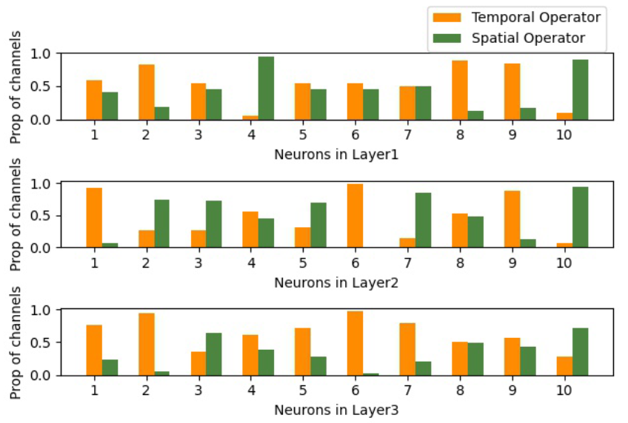
Visualization of Spatio-Temporal Specialization
Notes:
Here, we visualize the spread of our specialized neurons.
We observe that there is a diversity of spatio-temporal specializations among the specialized neurons in each layer, which allows it to handle fine-grained differences over a large range of spatio-temporal variations

Slide 15
Thank You!
Notes:
This is the end of the presentation.
Thank you very much for your kind attention.

